Slide 1
Lecture 4: Past, Present, and Future of Shadow Banking
Perry Mehrling
Warsaw School of Economics
October 16, 2017

Slide 2
past

Slide 3
The World that Bagehot Knew
Capital Markets vs. Money Markets
Bills of Exchange as “self-liquidating”
Funding Liquidity and Market Liquidity
Money Markets vs. Capital Markets
Original Lender of Last Resort
(Money) Markets vs. (Broker-Dealer) Institutions
Discounts vs. (Unsecured) Accommodations

Slide 4
The World that Moulton Knew
Capital Markets vs. Money Markets
Illiquid bank assets, No Central Bank, seasonal deposit volatility
High quality bonds as “shiftable”
Funding liquidity and market liquidity
Primitive Repo Market, Bankers Balances
Dealer of last resort
Promise to pay vs. Promise to buy

Slide 5
The First GFC
Federal Reserve failure, and transformation
1931 lender of last resort but not dealer of last resort
Banking Act of 1935, “apotheosis of shiftability”
Banking Act of 1937, “orderly conditions” tantamount to dealer of last resort, essential hybridity

Slide 6
Emerging norms of management
Keynes 1931 Treatise, normal backwardation
Keynes 1936 GT, liquidity preference
Hicks 1939, V&C, forward rate bias
Wartime hiatus, shift from UK to US
Fed-Treasury Accord 1951, FOMC 1952
Level of interest rates
“Tone” of the money market
But, academic Monetary Walrasianism, etc…

Slide 7
Present

Slide 8
“Making” Markets, Money and Risk
Capital Funding Bank Global Money Dealer Asset Manager
Derivative Dealer
Markets, money and risk, not institutions
Functional differentiation, not institutional
Assets | Liabilities | Assets | Liabilities | Assets | Liabilities
RMBS CDS IRS | MM funding | MM funding | “deposits” | “deposits” | Capital CDS IRS
Assets | Liabilities
Credit Default Swaps Interest Rate Swaps | Credit Default Swaps Interest Rate Swaps

Slide 9
Backstopping Market Making, First Resort
Capital Funding Bank Global Money Dealer Asset Manager
Derivative Dealer
Assets | Liabilities | Assets | Liabilities | Assets | Liabilities
RMBS CDS IRS | MM funding | MM funding Reserves | “deposits” Capital | “deposits” | Capital CDS IRS
Assets | Liabilities
CDS IRS Reserves | CDS IRS Capital

Slide 10
Backstopping Market Making, Second Resort
Capital Funding Bank Global Money Dealer Asset Manager
Derivative Dealer
Assets | Liabilities | Assets | Liabilities | Assets | Liabilities
RMBS CDS IRS FXS | MM funding | MM funding Reserves Liquidity put | “deposits” Capital | “deposits” | Capital CDS IRS FXS
Assets | Liabilities
CDS IRS FXS Reserves Liquidity Put | CDS IRS FXS Capital

Slide 11
Backstopping Market Making, Last Resort
Global Money Dealer
Derivative Dealer
Traditional Bank
Central Bank (or C6)
Assets | Liabilities
MM funding Reserves Liquidity put | “deposits”
Assets | Liabilities
CDS IRS FXS Reserves Liquidity put | CDS IRS FXS
Assets | Liabilities
Reserves Liquidity put CB | Liquidity put GMD Liquidity put DD
Assets | Liabilities
 | Reserves Liquidity put CB

Slide 12
Shadow Banking Boom
Capital Funding Bank Global Money Dealer Asset Manager
Derivative Dealer
Net demand for money, absorbed by dealer
Net demand for risk, absorbed by dealer
Assets | Liabilities | Assets | Liabilities | Assets | Liabilities
 |  |  | +“deposits” | +“deposits” | +Capital +CDS +IRS
Assets | Liabilities
+Credit Default Swaps +Interest Rate Swaps

Slide 13
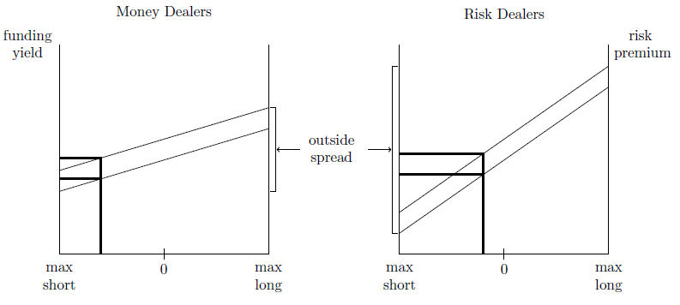
Shadow Banking Boom
Asset Manager distorts funding cost, risk premium

Slide 14
Shadow Banking Bust
Capital Funding Bank Global Money Dealer Asset Manager
Derivative Dealer
Net demand for funding, absorbed by dealer
Net demand for insurance, absorbed by dealer
Assets | Liabilities | Assets | Liabilities | Assets | Liabilities
+RMBS +CDS +IRS | +MM funding | +MM funding
Assets | Liabilities
 | +Credit Default Swaps +Interest Rate Swaps

Slide 15
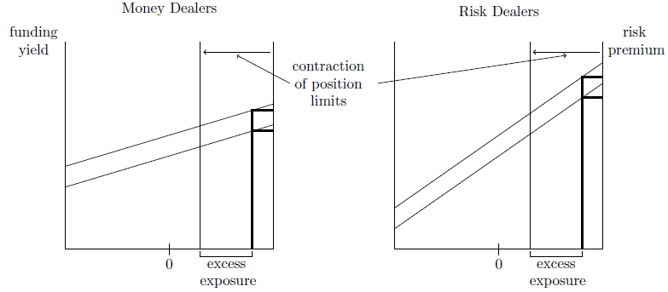
Shadow Banking Bust
Shadow Bank distorts funding cost, risk premium → CRISIS

Slide 16
Central Bank as Market Backstop
Dec 15, 2011 Dec 15, 2011 (restated)
Fed as Dealer of Last Resort
Global Money Dealer (OIS) [and FX swap]
Global Derivative Dealer (IRS, CDS)
Assets | Liabilities | Assets | Liabilities
Treasuries $1.7 MBS/GSE .9 Other .3 TOTAL 2.9 | Currency $1.0 Reserves 1.6 Other .3 TOTAL 2.9 | [TBill $2.6 [Tbond 2.6 [Risky Secs .9 Other .3 TOTAL 6.4? | Curr./Res. $2.6] Tbill 2.6] Tbond .9] Other .3 TOTAL 6.4?

Slide 17
Central Bank as Market Backstop
Dec 15, 2011 Dec 15, 2011 (restated)
Fed as Dealer of Last Resort
Global Money Dealer (OIS) [and FX swap]
Global Derivative Dealer (IRS, CDS)
Assets | Liabilities | Assets | Liabilities
Treasuries $1.7 MBS/GSE .9 Other .3 TOTAL 2.9 | Currency $1.0 Reserves 1.6 Other .3 TOTAL 2.9 | Other .3 TOTAL 6.4? | OIS $2.6 IRS 2.6 CDS .9 Other .3 TOTAL 6.4

Slide 18
future

Slide 19
Dealer Differentiation
Central Clearing Counterparties
Matched book dealers, utility
Money (Repo clearing)
Risk (Swap clearing)
Mismatched book dealing
Speculative dealers, harvesting liquidity premium
Money (Payment vs. Funding)
Risk (Futures vs. Forwards)

Slide 20
How It Works, Money
Dealer Bank CCP Customer 1
Dealer Bank CCP Customer 2
Dealer Bank makes market, bears risk, in interval between Customer 1 and Customer 2
Assets | Liabilities | Assets | Liabilities | Assets | Liabilities
+Repo, CCP | +Deposit | +Reverse, Customer | +Repo, Dealer | Bonds +Deposit | +Reverse, CCP
Assets | Liabilities | Assets | Liabilities | Assets | Liabilities
+Deposit | +Reverse, CCP | +Reverse, Dealer | +Repo, Customer | Cash -Deposit +Repo, CCP

Slide 21
How It Works, Risk
Dealer Bank CCP Customer 1
Dealer Bank CCP Customer 2
Dealer Bank makes market, bears risk, in interval between Customer 1 and Customer 2 trades
Assets | Liabilities | Assets | Liabilities | Assets | Liabilities
+Swap, CCP |  | +Swap, Customer | +Swap, Dealer |  | +Swap, CCP
Assets | Liabilities | Assets | Liabilities | Assets | Liabilities
 | +Swap, CCP | +Swap, Dealer | +Swap, Customer | +Swap, CCP

Slide 22
Liquidity in a Matched Book World
CFB GMD AM
DD
Abstracting from Counterparty Risk, Solvency Risk
Lending (RMBS collateral and rehypothecation)
Derivatives (Pre-funding and hedging)
Assets | Liabilities | Assets | Liabilities | Assets | Liabilities
RMBS 100 CDS 0 IRS 0 | MM 100 | MM 100 | Deposit 100 | Deposit 100 | Capital 100 CDS 0 IRS 0
Assets | Liabilities
CDS 0 IRS 0 | CDS 0 IRS 0

Slide 23
Value Fluctuation and Collateral Flows
CFB GMD AM
DD
Blocking a liquidity spiral (firesale of RMBS, CDS)
Lender of Last Resort to GMD, DD
Dealer of Last Resort for RMBS, CDS
Assets | Liabilities | Assets | Liabilities | Assets | Liabilities
RMBS 90 CDS 10 IRS 0 | MM 100 | MM 100 | Deposit 100 | Deposit 100 | Capital 90 CDS 10 IRS 0
Assets | Liabilities
CDS 10 IRS 0 | CDS 10 IRS 0

Slide 24
Value Fluctuation and Payment Flows
CFB GMD AM
DD
Blocking a liquidity spiral (firesale of RMBS, CDS)
Lender of Last Resort to GMD, DD
Dealer of Last Resort for RMBS, CDS
Assets | Liabilities | Assets | Liabilities | Assets | Liabilities
RMBS 90 CDS 10 IRS 0 | MM 100 | MM 100 | Deposit 100 | Deposit 100 | Capital 90 CDS 10 IRS 0
Assets | Liabilities
CDS 10 IRS 0 | CDS 10 IRS 0

Slide 25
Emergent IMS Liquidity Backstop
Dollar system, world reserve, private and international
Fed as public backstop for domestic dollar system
C6 swap lines as international extension
Bilateral swap lines connect C6 to others
E.g. BoJ/PBOC, BoE/PBOC
Regional arrangements connect farther out
Chiang Mai, EMS
IMF as public alternative, universal access
SDR as C5 swap line (dollar, euro, yen, pound, RMB)

Slide 26
International Hierarchy of Money
Dollar
C6 Swap Line
Bilateral Swaps, Regional Pooling, IMF
National Money
National Credit

Slide 27
IMS as payment system
Every nation is a bank, cash inflow, cash outflow (Kindleberger 1966)
Settlement as “survival constraint”, money as means of payment
Asymmetry of settlement, deficit agents pay surplus agents: discipline
Natural hierarchy of credit and money
Higher layers can offer delay of settlement to lower layers, for a price: elasticity

Slide 28
IMS as a Market-making System
Domestic money is part public, part private, with par maintained by two-way dealing
International money is part public, part private, with exchange rates maintained by two-way dealing
Profit-seeking dealers as suppliers of market liquidity (inside spread)
Interest rate swap and liquidity premium, vs. EH
FX swap and liquidity premium, vs. UIP
Central bank as FX dealer, backstopping market-making (outside spread)
Essential hybridity

Slide 29
International Hierarchy of Money
Spectrum of hybridity
Reserve currency: deep and liquid dealer markets, central bank backstop only
Peripheral Currency: central bank as market maker
Intermediate Cases
Exchange Rate Regimes
Floating
Fixed
Intermediate

Slide 30
Global Reach
Reserve Currency as special case
Global funding is dollar funding
Global coordination—C6 funding rates
Local adaptation, non-C6, periphery
Carry trades and UIP, public/private
Risk bearing and UDP, public/private

Slide 31
Plus ça change
“an effective, smoothly functioning international capital market is itself an instrument of world economic growth, not a nuisance which can be disposed of and the functioning of which can be transferred to new or extended inter-governmental institutions….the main requirement of international monetary reform is to preserve and improve the efficiency of the private capital market while building protection against its performing in a destabilizing fashion.” (Kindleberger et al, 1966)

